Slide 1
GPS MODULE
MODEL:
Beitian BN-220
How GPS Works:
GPS is a system of 30+ navigation satellites circling Earth. We know where they are because they constantly send out signals. A GPS receiver in your phone listens for these signals. Once the receiver calculates its distance from four or more GPS satellites, it can figure out where you are.

Slide 2
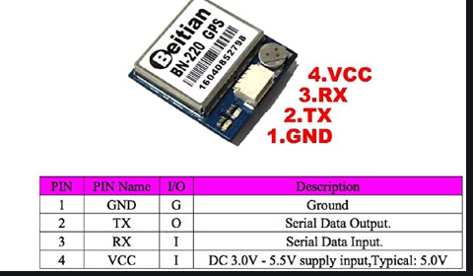
Pin Description:

Slide 3
Specification:
Accuracy Position Horizontal 2.0 m
Data Output Support Rate 4800bps to 921600bps, Default 9600bp
Power Consumption VCC DC Voltage 3.0V-5.5V, Typical: 5.0V
Connector 1.00mm 4pins connector
LED Built-in LED TX LED: blue. The data output, TX LED flashing

Slide 4
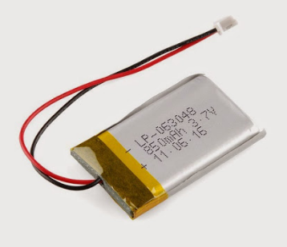
Power Supply:
Li-Ion Battery :
common in consumer electronics
low self-discharge rate
one of the best energy-to-weight ratios
slow loss of charge when not in use
Low Maintenance - no periodic discharge is needed
Specialty cells can provide very high current to applications such as power tools.

Slide 5
Limitations:
Requires protection circuit to maintain voltage and current within safe limits.
Subject to aging, even if not in use - storage in a cool place at 40% charge reduces the aging effect.
Transportation restrictions - shipment of larger quantities may be subject to regulatory control. This restriction does not apply to personal carry-on batteries.
Expensive to manufacture - about 40 percent higher in cost than nickel-cadmium.
Not fully mature - metals and chemicals are changing on a continuing basis.

Slide 6
Reference for GPS module:
https://www.am22tech.com/does-gps-use-internet-data/
Ref . For Li-Ion Battery:
https://batteryuniversity.com/learn/archive/is_lithium_ion_the_ideal_battery

